Slide 1
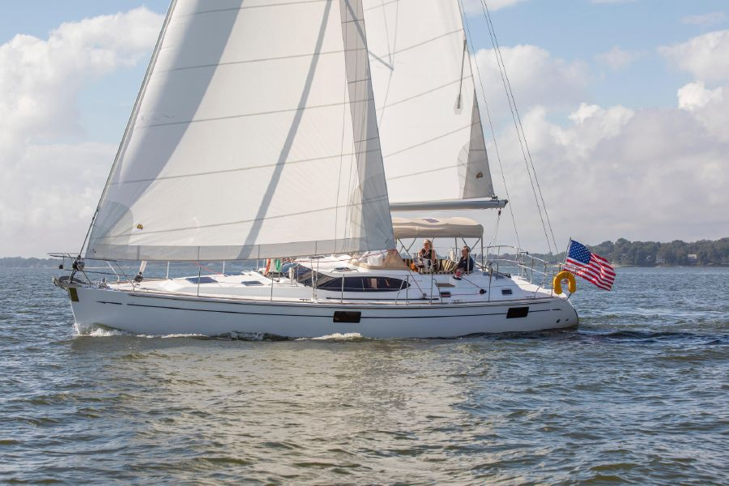
Metis Project 2: Scraping & Regression
Midsized Sailboat Valuations
By Sean Davern
Notes:
Good morning, everyone, I’m Sean Davern and I’m one of many people that love boating. In particular, I love sailing. To me, sailboats are beautiful manifestations of physics and engineering in practice. Today I’m here to tell you about some work I’ve done to help my fellow boating lovers. In particular, if you're dreaming about what it might be like to one day sail off into the sunset, you might want to know what they cost…

Slide 2

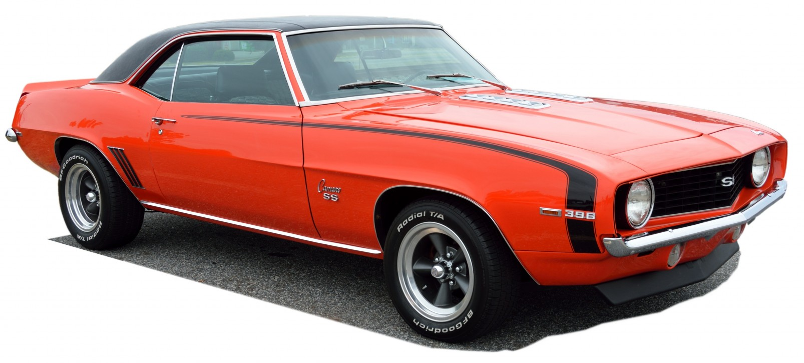

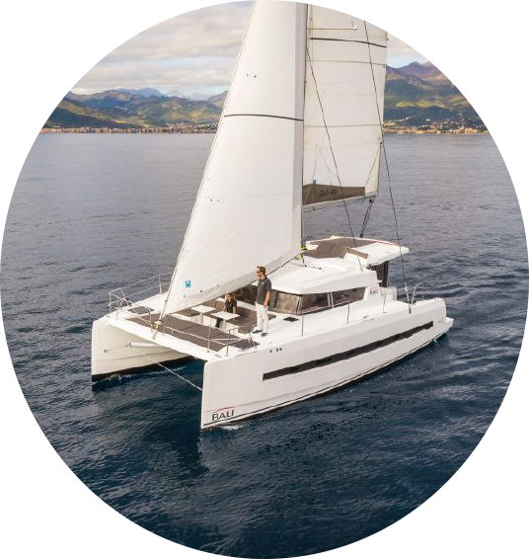

Individual Item Based Estimation
Make,
Model,
Year,
etc.
Make,
Model,
Year,
etc.
Notes:
Many people are familiar with estimating car prices using Kelley Blue Book.
There is a similar resource for boats and other recreational vehicles.
Great but if I don't know what makes, model, year, etc its much less helpful.
NADA = National Automobile Dealers Association owned by J.D. Power

Slide 3


Surveying the Market
Notes:
So, what most people do is simply go to the market place for boats. That's ok if you can afford a new boat, but it's much less helpful for the used boat market where most people start their boat ownership journey. Although it pales in comparison to getting on a boat, most people next turn to the internet.
Boat.com is the largest global search engine for the leisure marine market. This is what they find...

Slide 4
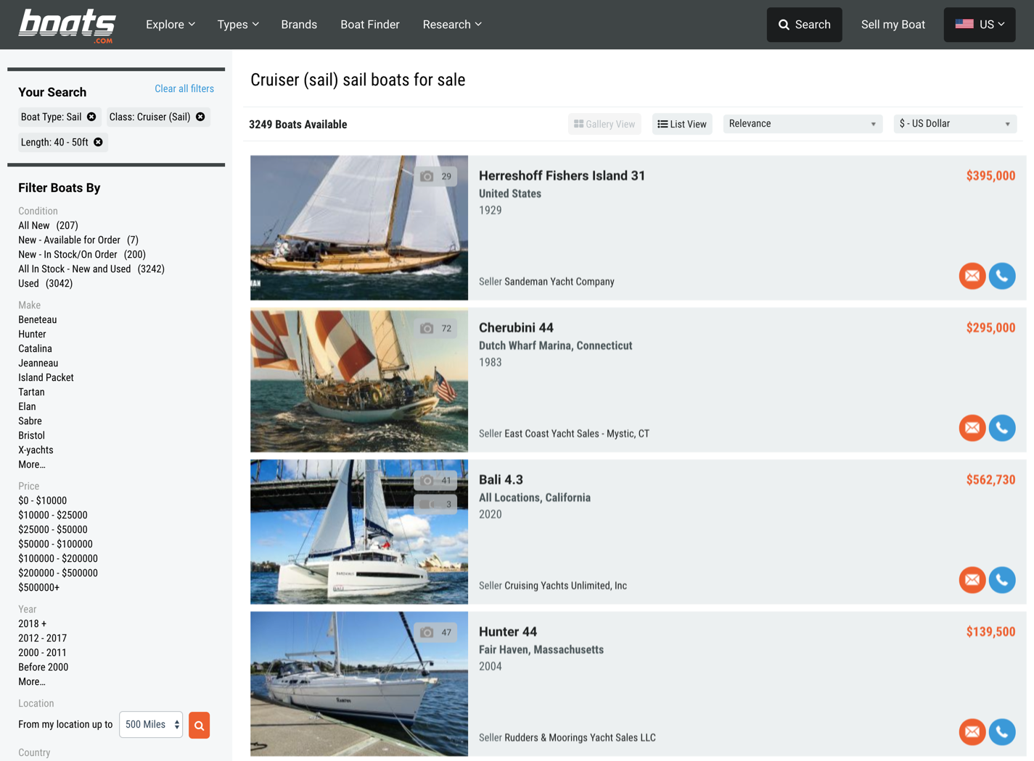
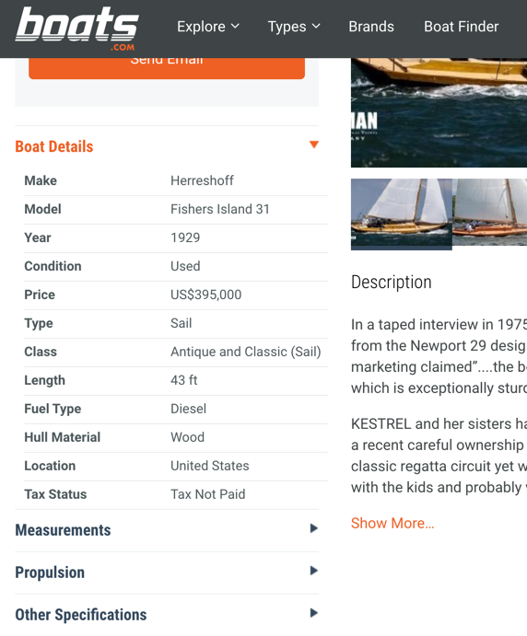
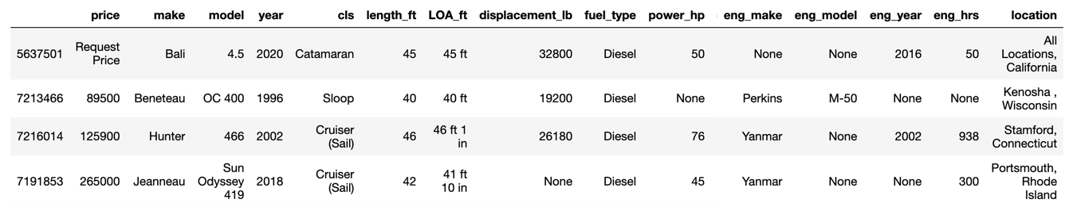
Gathering Data
Notes:
great to Browse
But how do I understand the trade-offs?
For example: Can I get a bigger boat if its older or another brand
It takes a lot of browsing to figure this out
I'm working to proposing a way to explore those trade-offs and it would be powered by a pricing model. To get that model... 1:45

Slide 5
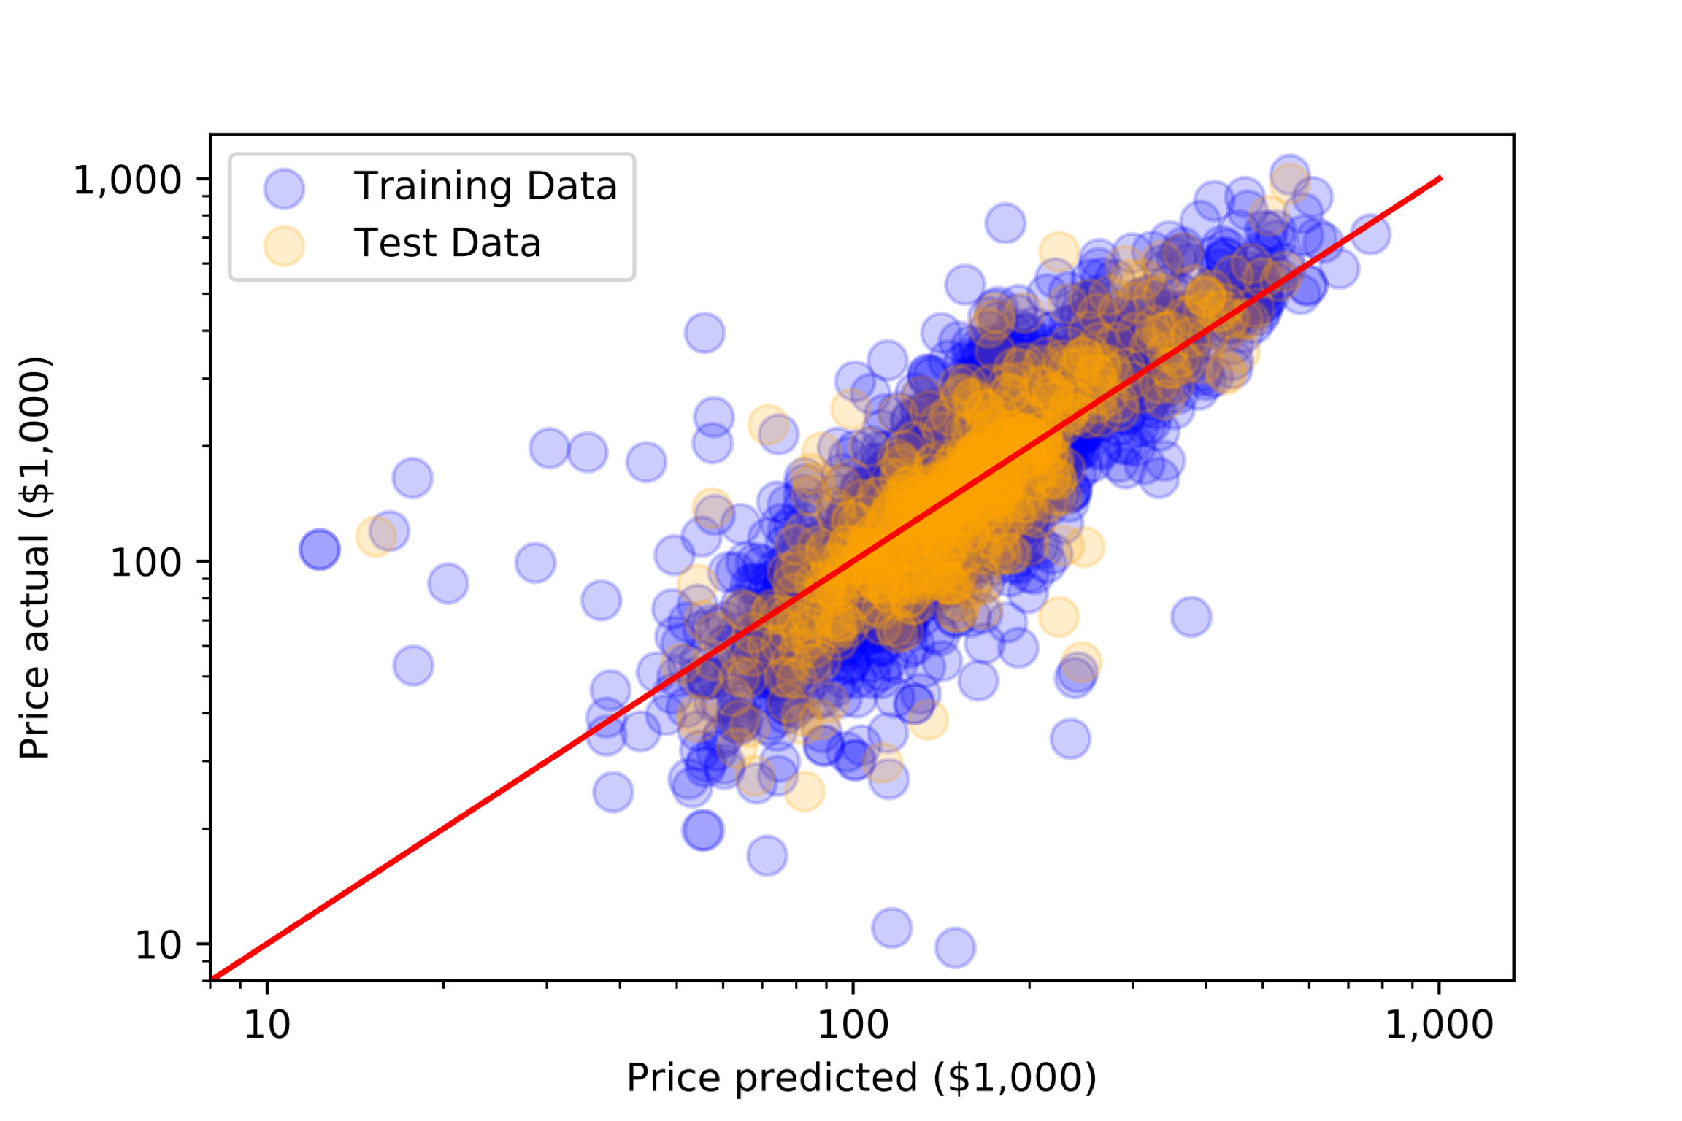
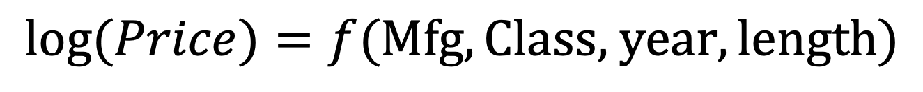
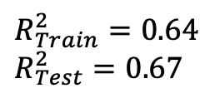
Current Model Results
$$log⁡(Price)=f(\text{Mfg},\text{Class}\text{, }\text{year}, \text{length})$$
Linear Regression Using 5 fold Cross Validation and LASSO Regularization
$$R_{Train}^{2}=0.64$$
$$R_{Test}^{2}=0.67$$
Notes:
Although still incomplete, the current model is a linear regression
LASSO = Least Absolute Shrinkage and Selection Operator
lambda * Sums absolute values of coef
Reduce model complexity
reduces variance - improves prediction accuracy
404 unique Mfg’s – 298 had only 1 or 2 boats to represent the Mfg = Total of 354 boats → Classified as ”Other”
Resulting in 107 Mfg’s
3 of the 16 class coefficients were shrunk to 0 by LASSO
23 of 107 mfg coefficients were shrunk to 0 by LASSO
Fairly well distributed predictions with lackluster but promising R2

Slide 6
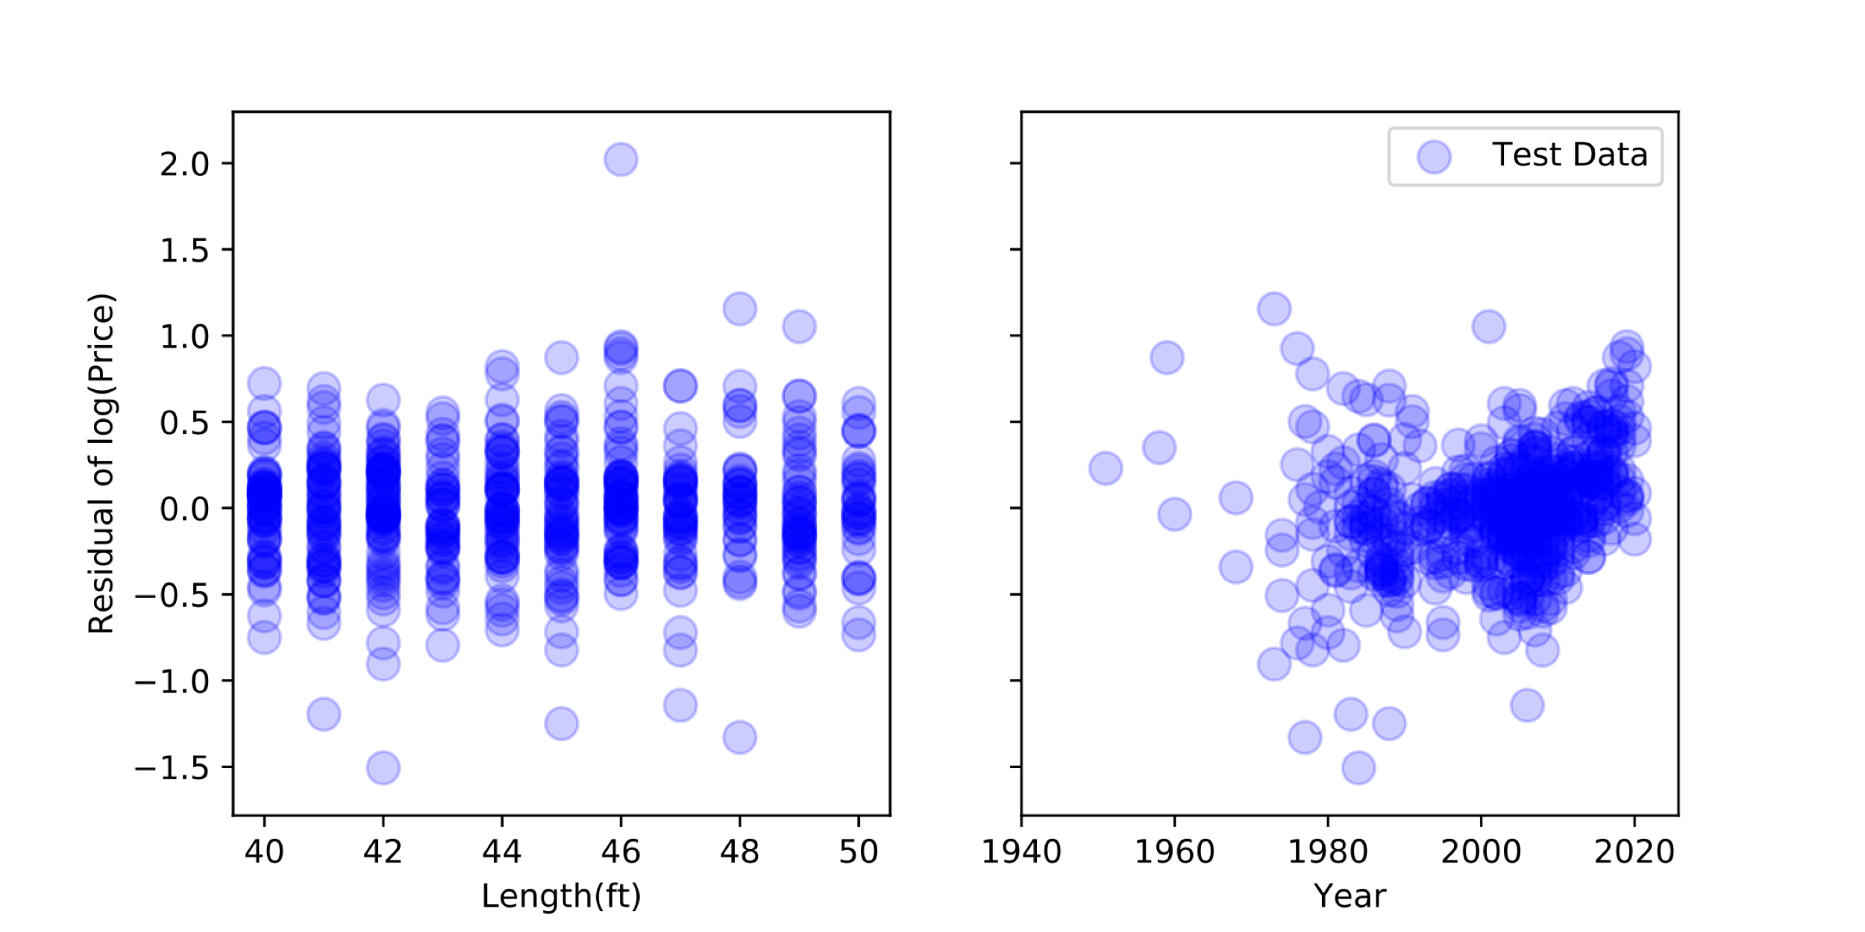
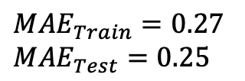
Current Model Results
$$log⁡(Price)=f(\text{Mfg},\text{Class}\text{, }\text{year}, \text{length})$$
Linear Regression Using 5 fold Cross Validation and LASSO Regularization
$${MAE}_{Train}=0.27$$
$${MAE}_{Test}=0.25$$
Notes:
Distribution of residuals across Length is pretty consistent
An interesting pattern turns up with age. Older boat can get more expensive: presumably antique or less expensive as the deteriorate.
Because I’m modeling the log of the price, a mean absolute error of 0.26 equates to about a 30% error which isn’t that far from the 10% error the NADA guide claims and perhaps acceptable for someone at this point in the boat buying process.

Slide 7

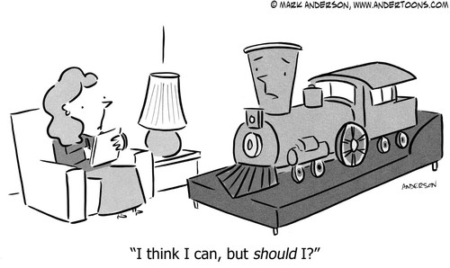
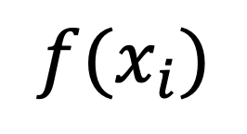
Future Work
$$f(x_{i})$$
Location
Age*Antique
Regularize ALL Mfg’s
Notes:
3:15
Model improvements:
Integrate location
Add age * Antique interaction OR
Include All Mfg & let regularization shrink
The model is currently based on listing data. Perhaps it should be based on NADA valuations.
Or perhaps all currently listed boats should be valued using NADA and those estimates modeled.
Finally, the effort so far seems to be validating that a adequate cost model might be feasible.
Perhaps the next exercise should be to validate the utility of the model.
Currency: 1813 Euro, 757 US$, 269 British Pound

Slide 8


Slide 9
Appendix

Slide 10
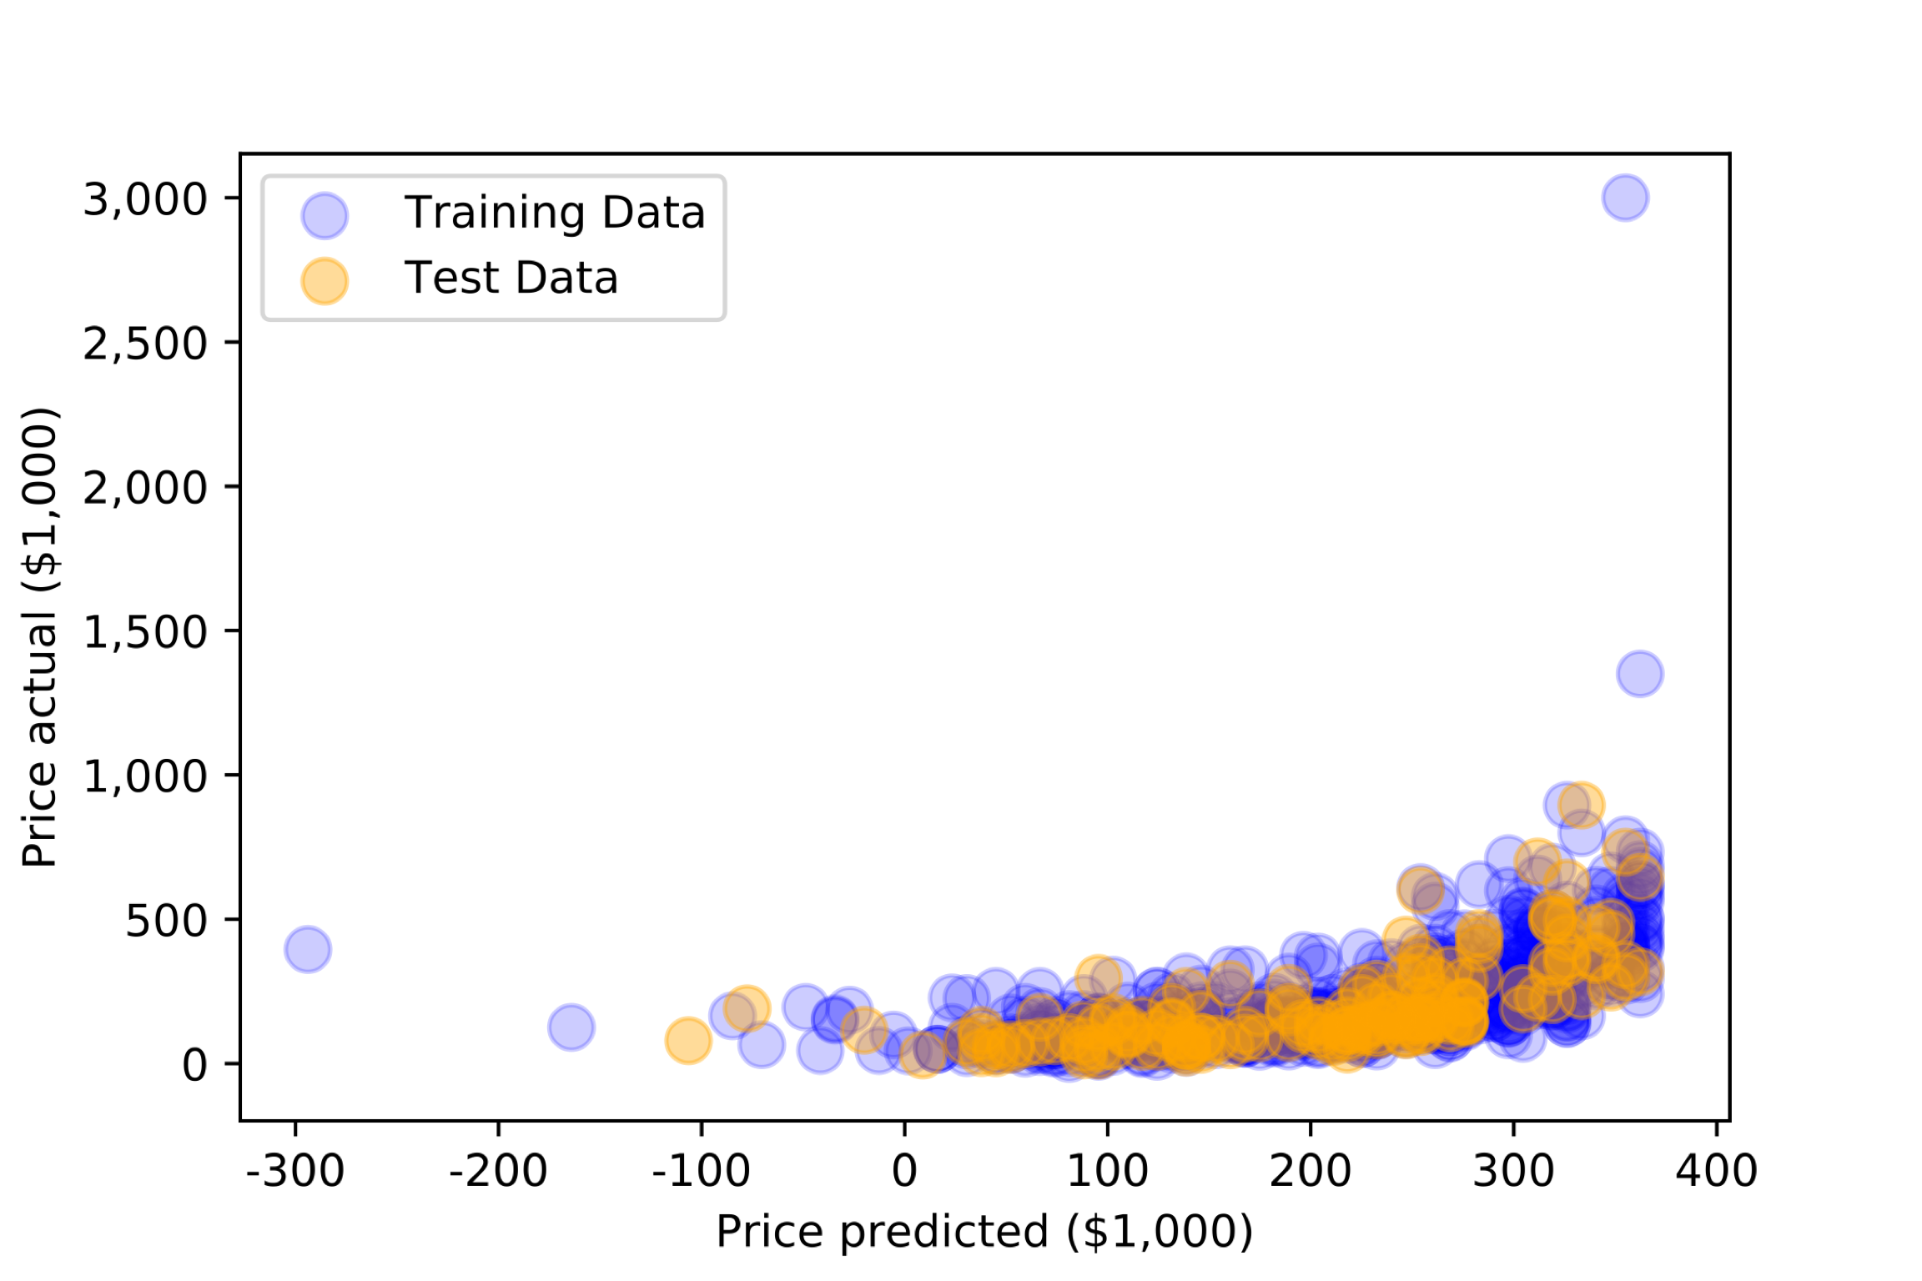
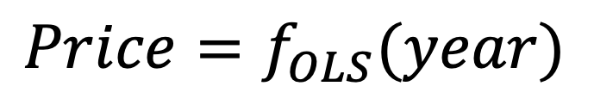
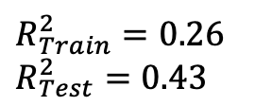
MVP (Minimum Viable Product)
$$Price=f_{OLS}(year)$$
$$R_{Train}^{2}=0.26$$
$$R_{Test}^{2}=0.43$$

Slide 11
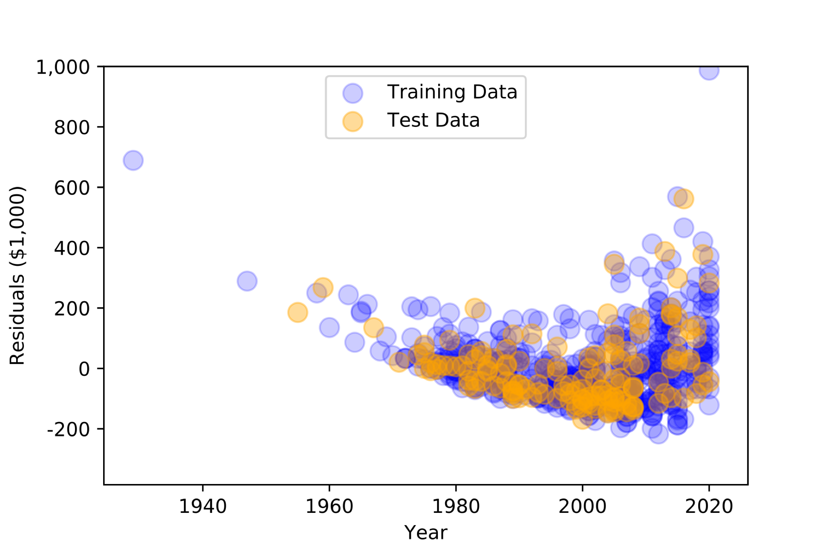
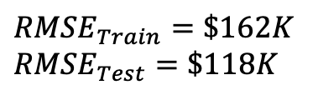
MVP
$$Price=f_{OLS}(year)$$
$$RMSE_{Train}=\$162K$$
$$RMSE_{Test}=\$118K$$

Slide 12
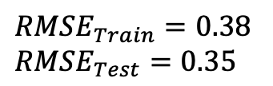
Current Model Results
$$log⁡(Price)=f(\text{Mfg},\text{Class}\text{, }\text{year}, \text{length})$$
Linear Regression Using 5 fold Cross Validation and LASSO Regularization
$$RMSE_{Train}=0.38$$
$$RMSE_{Test}=0.35$$
Notes:
Distribution of residuals across Length is pretty consistent
An interesting pattern turns up with age. Older boat can get more expensive: presumably antique or less expensive as the deteriorate.
Because I’m modeling the log of the price, a mean absolute error of 0.26 equates to about a 30% error which isn’t that far from the 10% error the NADA guide claims and perhaps acceptable for someone at this point in the boat buying process.

